Slide 1
DSL Design
A conceptual framework
for building good DSLs
based on material
from a paper written
with Eelco Visser
Markus Voelter
independent/itemis
voelter@acm.org
www.voelter.de
voelterblog.blogspot.de
@markusvoelter
+Markus Voelter
E.Visser@tudelft.nl
http://eelcovisser.org/

Slide 2

This material is based on this book:
http://dslbook.org
available Feb 2013
www.dslbook.org

Slide 3
Introduction

Slide 4
A DSL is a focussed, processable language for describing a specific concern when building a system in a specific domain. The abstractions and notations used are natural/suitable for the stakeholders who specify that particular concern.

Slide 5
Concepts (abstract syntax) (concrete) Syntax semantics (generators) Tools and IDE

Slide 6
 | more in GPLs | more in DSL
Domain Size | large and complex | smaller and well-defined
Designed by | guru or committee | a few engineers and domain experts
Language Size | large | small
Turing-completeness | almost always | often not
User Community | large, anonymous and widespread | small, accessible and local
In-language abstraction | sophisticated | limited
Lifespan | years to decades | months to years (driven by context)
Evolution | slow, often standardized | fast-paced
Incompatible Changes | almost impossible | feasible

Slide 7
General Purpose
C
Components
Domain Specific
State Machines
Sensor Access
LEGO Robot Control

Slide 8
Big Language
L
c
d
e
b
f
g
h
i
j
k
m
n
o
a
with many first class concepts!

Slide 9
Small Language
L
α
β
λ
ω
δ
with a few, orthogonal
and poweful concepts

Slide 10
Modular Language
my L
α
β
a
b
c
d
e
f
g
h
i
j
k
l
with many optional,
composable modules

Slide 12
Case Studies

Slide 13
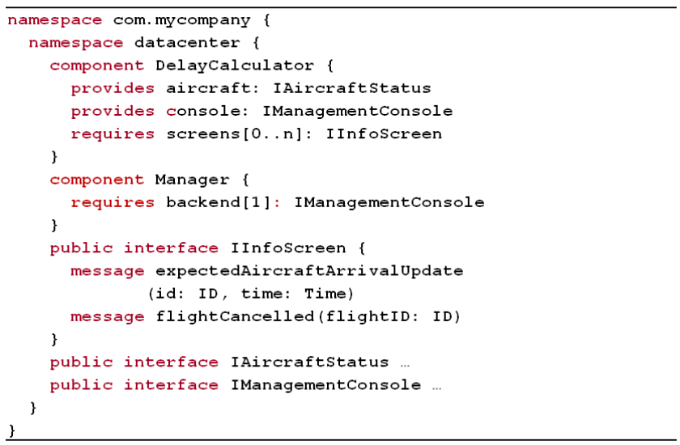
Example
Compo nents

Slide 14
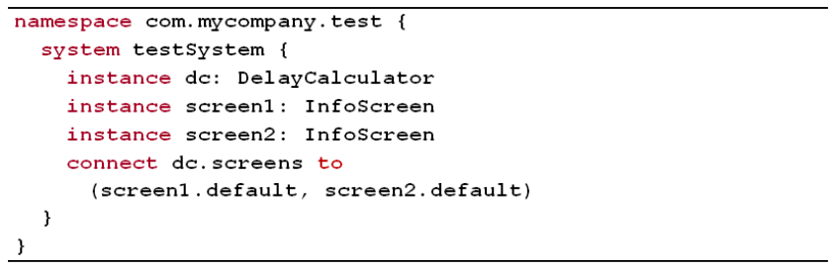
Example
Compo nents

Slide 15
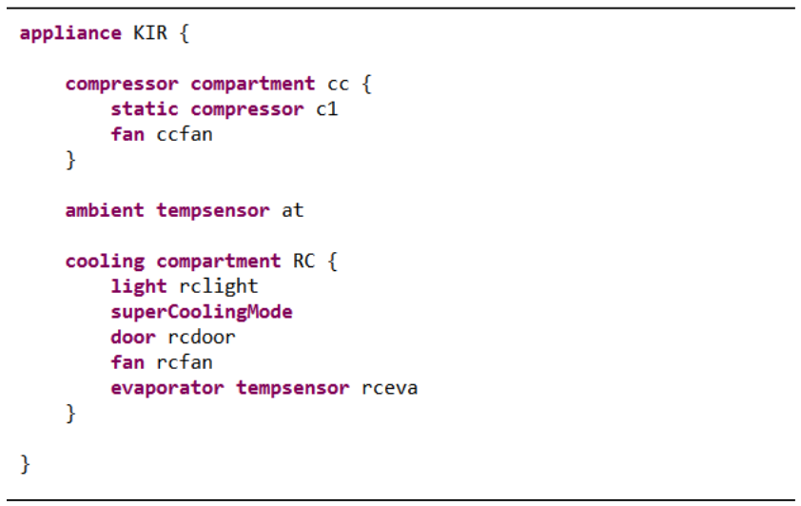
Example
Refrigerators
Refrigerators

Slide 16
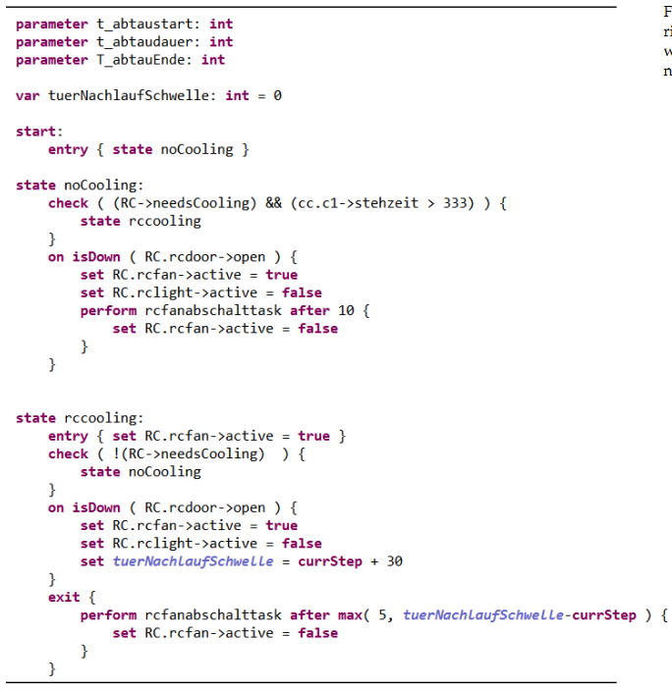
Example
Refrigerators

Slide 17
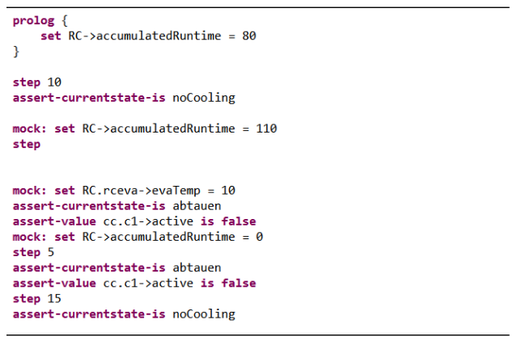
Example
Refrigerators

Slide 18
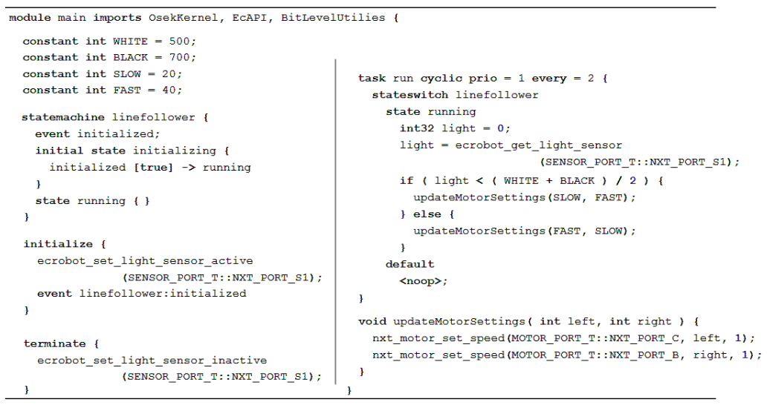
Example
Exten
ded C

Slide 19
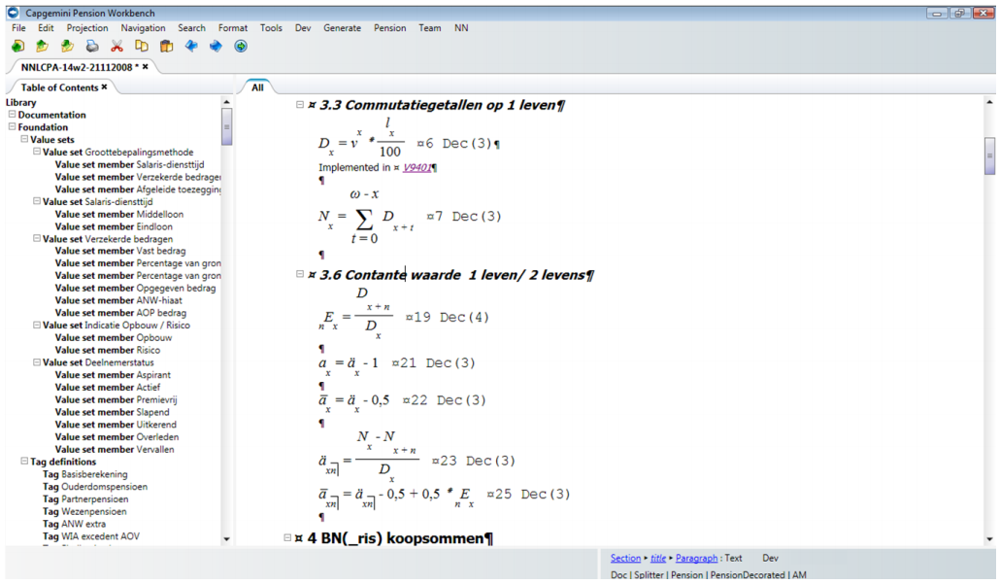
Example
Pension Plans

Slide 20
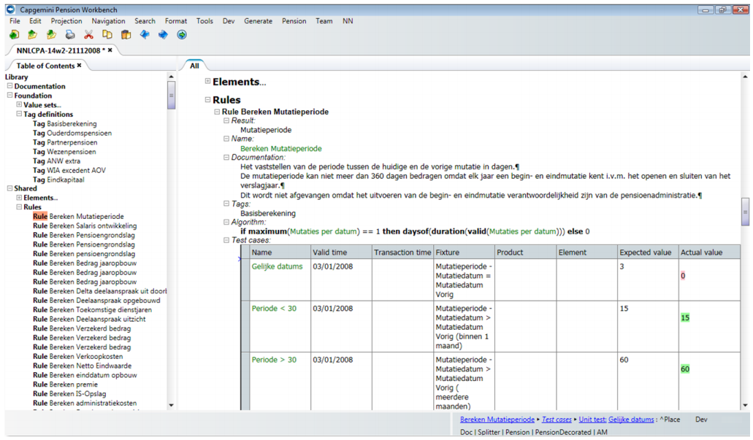
Example
Pension Plans

Slide 21
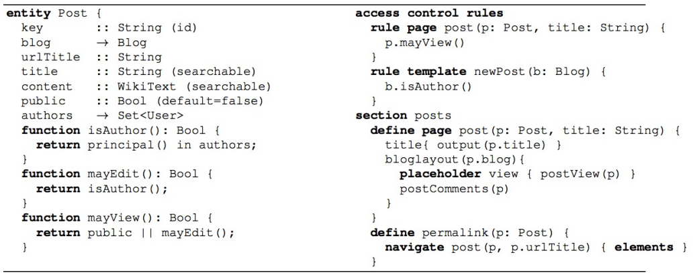
Example
Web
DSL

Slide 23
Terms & Concepts

Slide 24

Model
A schematic description of a system, theory, or phenomenon that accounts for its known or inferred properties and may be used for further study of its characteristics
www.answers.com/topic/model

Slide 25
Model
A representation of a set of components of a process, system, or subject area, generally developed for understanding, analysis, improvement, and/or replacement of the process
www.ichnet.org/glossary.htm

Slide 26
Model
an abstraction or simplification of reality
ecosurvey.gmu.edu/glossary.htm

Slide 27
Model
which ones?
an abstraction or simplification of reality
what should we leave out?
ecosurvey.gmu.edu/glossary.htm

Slide 28
Model Purpose
… code generation
… analysis and checking
… platform independence
… stakeholder integration
…
drives design of
language!

Slide 29
Model Purpose
… code generation
… analysis and checking
… platform independence
… stakeholder integration
Example
Compo nents

Slide 30
Model Purpose
… code generation
… analysis and checking
… platform independence
… stakeholder integration
Example
Refrigerators
Refrigerators

Slide 31
Model Purpose
… code generation
… analysis and checking
… platform independence
… stakeholder integration
Example
Extended C
Exten
ded C

Slide 32
Model Purpose
… code generation
… analysis and checking
… platform independence
… stakeholder integration
Example
Pension
Plans

Slide 33
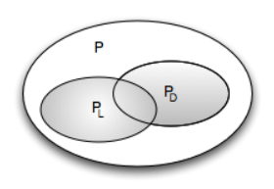
Programs Languages Domains

Slide 34
Domain
body of knowledge
in the real world
deductive
top down
inductive
bottom up
existing software (family)

Slide 35
Domain
body of knowledge
in the real world
deductive
top down
Example
Example
Refrigerators
Penion
Plans
Refrige
rators

Slide 36
Domain
Domain
inductive
bottom up
existing software (family)
Example
Example
Exten
ded C
Compo
netns

Slide 37
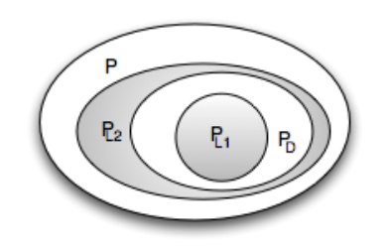
A DSL L_{D} for D is a language that is specialized to en-coding P_{D} programs.
more efficient
smaller

Slide 38
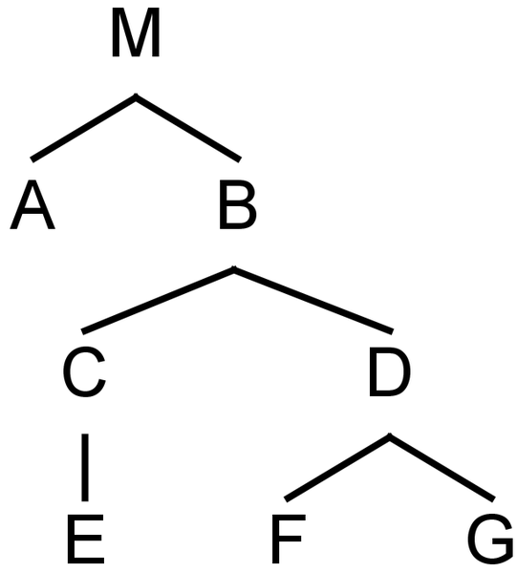
Programs are trees
element

Slide 39
Fragments are subtrees w/ root
fragment root
f
fragment

Slide 40
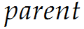
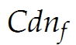
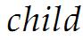
Parent-Child Relation
f

Slide 41
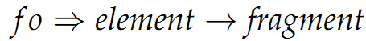
Programs and Fragments
f

Slide 42
Programs are graphs, really.
reference

Slide 43
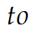
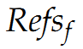
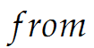
Programs are graphs, really.

Slide 44
Languages are sets of concepts
C₂
C₁
C_{n}
C₃
L

Slide 45
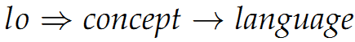
Languages are sets of concepts
C₂
C₁
C_{n}
C₃
L

Slide 46
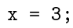
Programs and languages
C₂
C₁
C_{n}
C₃

Slide 47
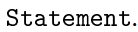
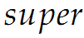
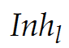
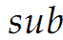
Language: concept inheritance
C₂
C₁
L₁
C₃
L₂
C₁

Slide 48
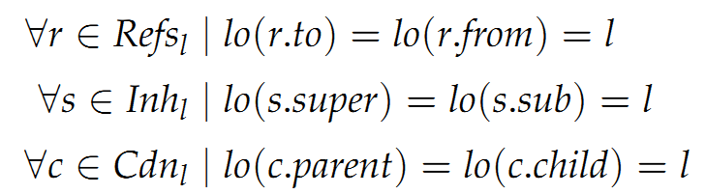
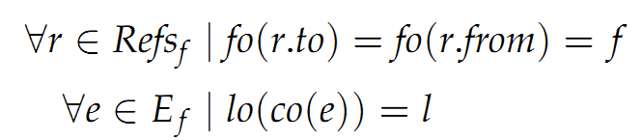
Independence
Language
does not depend on any other language
Fragment
does not depend on any other fragment

Slide 49
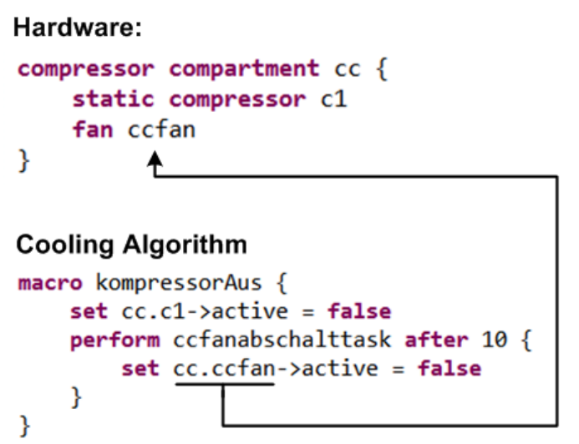
Independence
Example
Refrige
rators

Slide 50
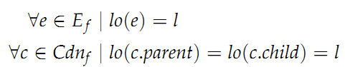
Homogeneous
Fragment
everything expressed with one language

Slide 51
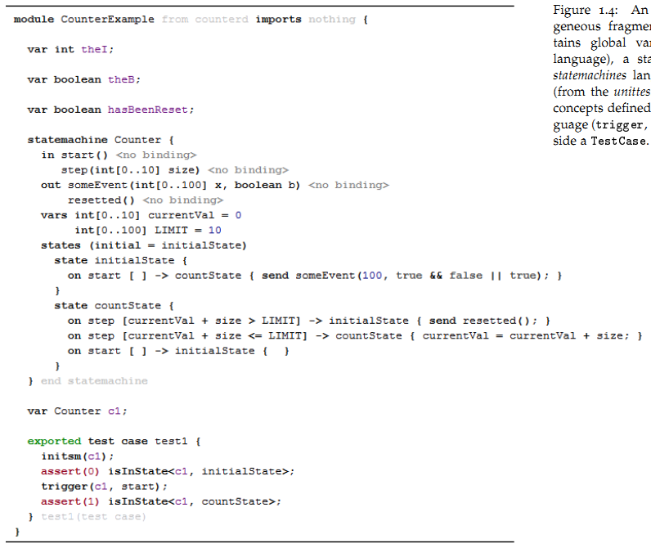
Heterogeneous
Heterogeneous
Example
Exten
ded C

Slide 52
Heterogeneous
Heterogeneous
C
Statemachines
Testing
Example
Exten
ded C

Slide 53
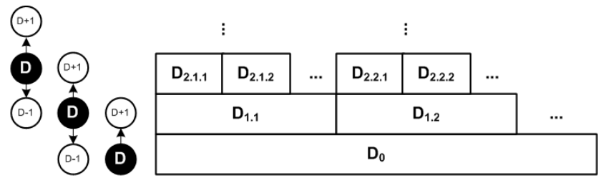
Domain Hierarchy

Slide 54
Domain Hierarchy
avionics
automotive
embedded
software
all programs
Example
Exten
ded C

Slide 56
Design Dimensions
expressivity
coverage
semantics
separation of concerns
completeness
paradigms
modularity
concrete syntax
process

Slide 57
Expressivity
expressivity
coverage
semantics
separation of concerns
completeness
paradigms
modularity
concrete syntax
process

Slide 58
Shorter Programs
More Accessible Semantics

Slide 59
For a limited
Domain!
Domain Knowledge encapsulated in language

Slide 60
Def: Expressivity

Slide 61
Smaller Domain
More Specialized Language
Shorter Programs

Slide 62
The do-what-I-want language
Ѱ

Slide 63
Single Program vs. Class/Domain
No Variability!
Ѱ

Slide 64
Domain Hierarchy
more specialized domains
more specialized languages

Slide 65
Reification
D_{n}

Slide 66
Reification
D_{n+1}
==
D_{n}

Slide 67
Reification
Transformation/ Generation
==
Language
Definition

Slide 68
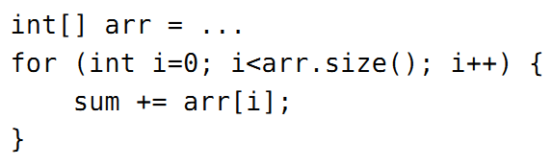
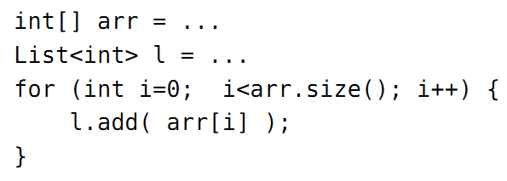
?

Slide 69
?
Overspecification!
Requires Semantic Analysis!

Slide 70
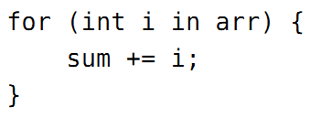
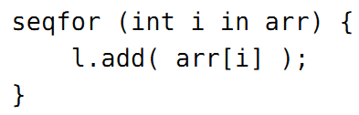
!
Linguistic Abstraction
Declarative!
Directly represents Semantics.

Slide 71
Def: DSL
A DSL is a language at D that provides linguistic abstractions for common patterns and idioms of a language at D-1 when used within the domain D.

Slide 72
Def: DSL cont’d
A good DSL does not require the use of patterns and idioms to express semantically interesting concepts in D.
Processing tools do not have to do “semantic recovery” on D programs.
Declarative!

Slide 73
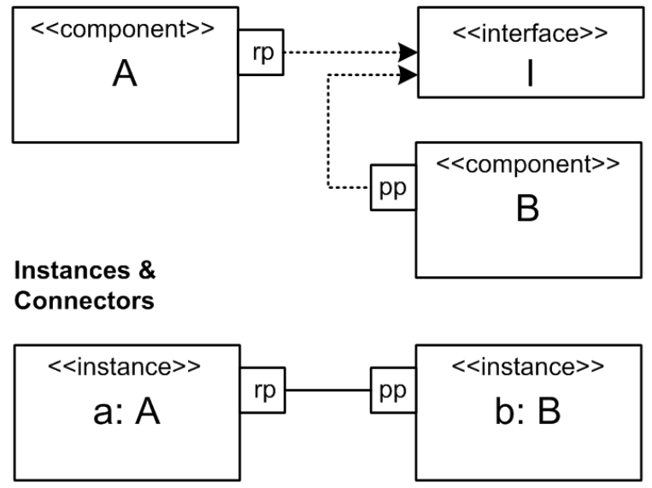
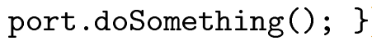
Another Example
Example
Exten
ded C

Slide 74
Another Example
Example
Exten
ded C
Turing Complete!
Requires Semantic Analysis!

Slide 75
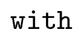
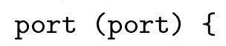
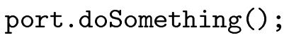
Linguistic Abstraction
Example
Exten
ded C

Slide 76
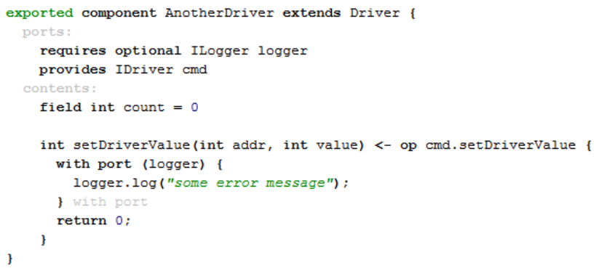
Linguistic Abstraction
Example
Exten
ded C

Slide 77
Linguistic Abstraction
In-Language
Abstraction
Libraries
Classes
Frameworks

Slide 78
Linguistic Abstraction
Analyzable
Better IDE Support
In-Language
Abstraction
User-Definable
Simpler Language

Slide 79
Linguistic Abstraction
Special
Treatment!
Analyzable
Better IDE Support
In-Language
Abstraction
User-Definable
Simpler Language

Slide 80
Std Lib
Linguistic Abstraction
In-Language
Abstraction

Slide 81
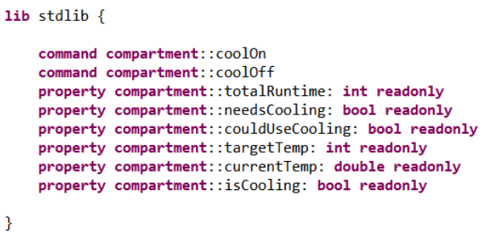
Std Lib
Example
Refrige
rators

Slide 82
Language Evolution Support

Slide 83
Customization
vs.
Configuration

Slide 84
Precision
vs.
Algorithmics

Slide 86
Coverage
expressivity
coverage
semantics
separation of concerns
completeness
paradigms
modularity
concrete syntax
process

Slide 87
Domain D_{L} defined inductively by L
(the domain that can be expressed by L)
C_{L}(L) == 1 (by definition)
not very interesting!

Slide 88
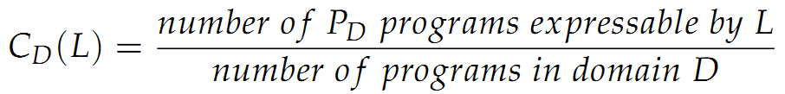
Def: Coverage
to what extend can a language L cover a domain D

Slide 89
Def: Coverage
why would C_{D}(L) be != 1?
1) L is deficient
2) L is intended to cover only a subset of D,
corner cases may make L
too complex
Rest must be expressed in D₋₁

Slide 90
Def: Coverage
Coverage is full.
You call always write C.
Example
Exten
ded C

Slide 91
Def: Coverage
Only a particular style of web apps are suported.
Many more are conceivable.
Example
WebDSL

Slide 92
Def: Coverage
DSLs are continuously evolved so the relevant parts of the deductive domain are
supported.
Example
Example
Example
Compo
nents
Refrige
rators
Pension
Plans

Slide 94
Semantics & Execution
expressivity
coverage
semantics
separation of concerns
completeness
paradigms
modularity
concrete syntax
process

Slide 95
Static Semantics
Execution Semantics

Slide 96
Static Semantics
Execution Semantics

Slide 97
Static Semantics
Constraints
Type Systems

Slide 98
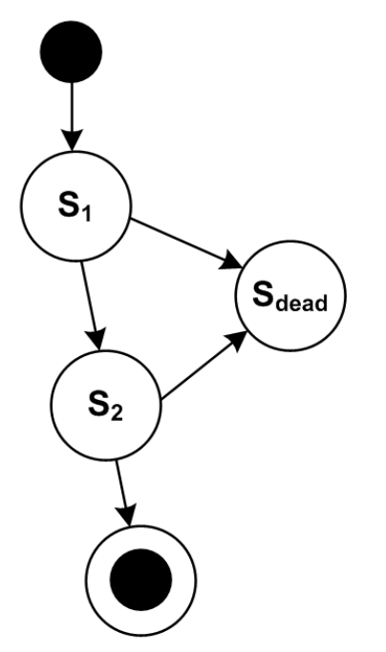
Unique State Names
Unreachable States
Dead End States
…
Example
Exten
ded C

Slide 99
Unique State Names
Unreachable States
Dead End States
…
Easier to do on a declarative Level!
Example
Exten
ded C

Slide 100
Unique State Names
Unreachable States
Dead End States
…
Easier to do on a declarative Level!
Example
Thinking of all constraints is a coverage problem!
Exten
ded C

Slide 101
Assign fixed types
What does a type system do?

Slide 102
Assign fixed types
Derive Types
What does a type system do?

Slide 103
Assign fixed types
Derive Types
Calculate Common Types
What does a type system do?

Slide 104
Assign fixed types
Derive Types
Calculate Common Types
Check Type Consistency
What does a type system do?

Slide 105
Derive
Intent +
Check
More code
More convenient
Better error messages
More complex checkers
Better Performance
Harder to understand for users

Slide 106
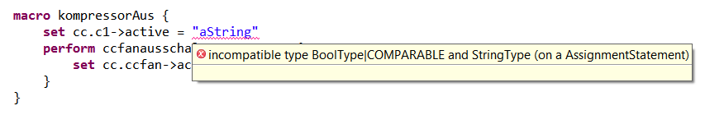
Example
Refrige
rators

Slide 107
What does it all mean?
Execution Semantics

Slide 108
Def: Semantics
… via mapping to lower level
OB: Observable Behaviour (Test Cases)

Slide 109
Def: Semantics
… via mapping to lower level
L_{D}
Transformation
Interpretation
L_{D-1}

Slide 110

Transformation
D_{n+1}
D_{n}

Slide 111
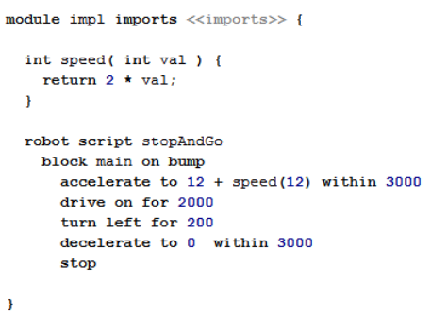
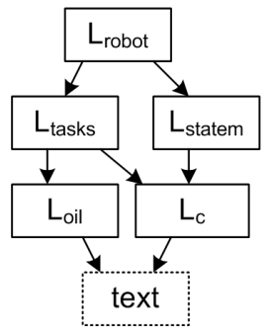
Transformation
Example
Exten
ded C

Slide 112
Transformation
L_{D}
Transformation
L_{D-1}
Known Semantics!

Slide 113
Transformation
L_{D}
Correct!?
Transformation
L_{D-1}

Slide 114
Transformation
Tests (D)
L_{D}
Transformation
Tests (D-1)
L_{D-1}
Run tests on both levels; all pass.
Coverage Problem!

Slide 115
Example
Refrigerators

Slide 116
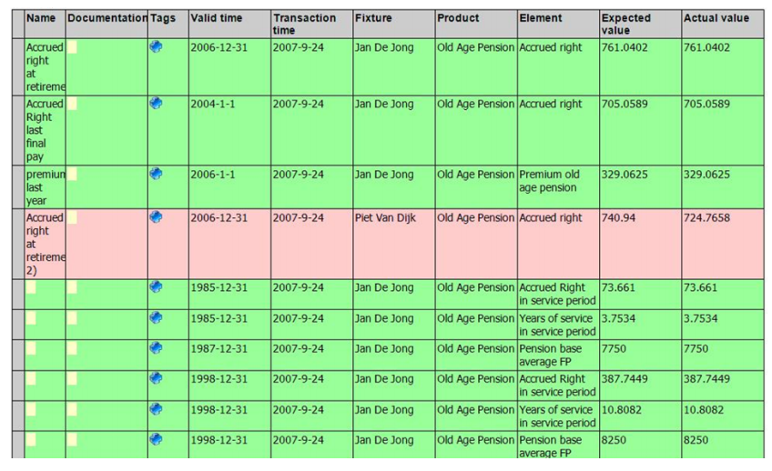
Transformation
Example
Pension
Plans

Slide 117
Transformation
Tests
Simulators
Documentation
L_{D}
Transformation
L_{D-1}

Slide 118
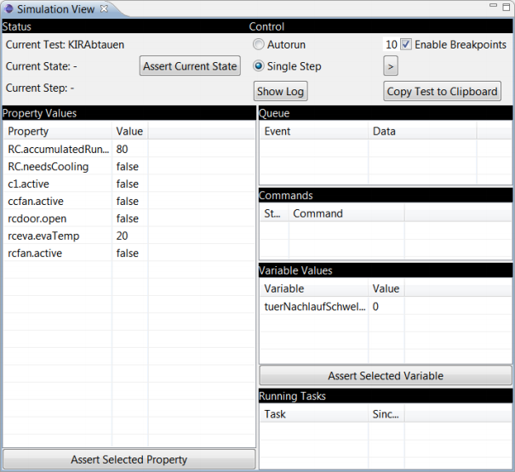
Behavior
Example
Refrigerators

Slide 119
Multi-Stage
L₃
L₂
Modularization
L₁
L₀

Slide 120
Multi-Stage: Reuse
L₃
L₂
L₅
L₁
Reusing Later Stages
Optimizations!
L₀

Slide 121
Multi-Stage: Reuse
L₃
Robot Control
State Machine
L₂
L₅
Components
L₁
C (MPS tree)
Example
L₀
C Text
Exten
ded C

Slide 122
Multi-Stage: Reuse
Robot Control
L₃
State Machine
Consistency
Model Checking
L₂
L₅
Components
Efficient Mappings
C Type System
L₁
C (MPS tree)
Syntactic
Correctness, Headers
Example
L₀
C Text
Exten
ded C

Slide 123
Multi-Stage: Reuse
L₃
Reusing Early Stages
Portability
L₂
L₁
L_{1b}
L₀
L_{0b}

Slide 124
Multi-Stage: Reuse
L₃
L₂
L₁
L_{1b}
Java
C#
Example
L₀
L_{0b}
Exten
ded C

Slide 125
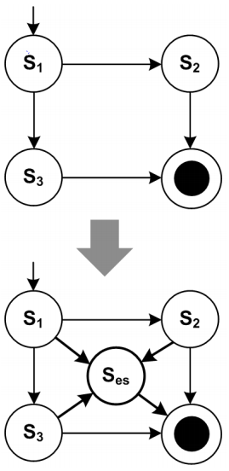
Multi-Stage: Preprocess
Adding an
optional, modular emergency
stop feature

Slide 126


Platform

Slide 127
Platform
Temporal Data
Versioning
Database Access
Transactions
Distribution
(JEE)
Example
Pension
Plans

Slide 128
Platform
Data Collection
HAL
Device
Drivers
Example
Refrige
rators

Slide 129

Interpretation
A program at D₀ that
acts on the structure
of an input program at D_{>0}

Slide 130
Interpretation
A program at D₀ that
acts on the structure
of an input program at D_{>0}
imperative → step through
functional → eval recursively
declarative→ ? solver ?

Slide 131
Example
Pension
Plans

Slide 132
Example
Refrigerators

Slide 133
Behavior
Example
Refrigerators

Slide 134
Interpretation
A program at D₀ that
acts on the structure
of an input program at D_{>0}

Slide 135
Interpretation
An interpreter :-)

Slide 136
Transformation
Interpretation

Slide 137
Transformation
Interpretation
+ Code Inspection

Slide 138
Transformation
Interpretation
+ Code Inspection
OSGi Generators
Example
Compo nents

Slide 139
Transformation
Interpretation
+ Code Inspection
+ Debugging

Slide 140
Transformation
Interpretation
+ Code Inspection
+ Debugging
Platform Inter-
actions
Example
Refrige
rators

Slide 141
Transformation
Interpretation
+ Code Inspection
+ Debugging
+ Performance &
Optimization

Slide 142
Transformation
Interpretation
+ Code Inspection
+ Debugging
+ Performance &
Optimization
Efficiency for
Real-Time S/w
Memory Use
Example
Exten
ded C

Slide 143
Transformation
Interpretation
+ Code Inspection
+ Debugging
+ Performance &
Optimization
+ Platform Con- formance

Slide 144
Transformation
Interpretation
+ Code Inspection
+ Debugging
+ Performance &
Optimization
+ Platform Con- formance
Example
Web Frameworks
and Standards
Web
DSL

Slide 145
Transformation
Interpretation
+ Code Inspection
+ Turnaround Time
+ Debugging
+ Performance &
Optimization
+ Platform Con- formance

Slide 146
Transformation
Interpretation
+ Code Inspection
+ Turnaround Time
Testing
+ Debugging
+ Performance &
Optimization
+ Platform Con- formance
Example
Example
Pension
Plans
Refrige
rators

Slide 147
Transformation
Interpretation
+ Code Inspection
+ Turnaround Time
+ Debugging
+ Runtime Change
+ Performance &
Optimization
+ Platform Con- formance

Slide 148
Transformation
Interpretation
+ Code Inspection
+ Turnaround Time
+ Debugging
+ Runtime Change
+ Performance &
Optimization
Change Business
Rules without
Redeployment
+ Platform Con- formance
Example
Pension
Plans

Slide 149
Def: Semantics
… via mapping to lower level
L_{D}
Transformation
Interpretation
L_{D-1}

Slide 150
Multiple Mappings
… at the same time
L_{D}
Similar Semantics?
L_{x}
L_{y}
L_{z}

Slide 151
Multiple Mappings
… at the same time
L_{D}
T
Similar Semantics?
L_{x}
L_{y}
L_{z}
T
T
T
all green!

Slide 152
Multiple Mappings
… at the same time
L_{D}
T
Similar Semantics?
L_{x}
L_{y}
L_{z}
T
T
T
all green!

Slide 153
Example
Pension
Plans

Slide 154
Example
Refrigerators

Slide 155
Multiple Mappings
… alternatively, selectably
L_{D}
Extend L_{D} to include explicit data that determines transformation
L_{x}
L_{y}
L_{z}

Slide 156

Multiple Mappings
… alternatively, selectably
L_{D}
Extend L_{D} to include explicit data that determines transformation
L_{x}
L_{y}
L_{z}
Example
Exten
ded C
Restricted Port leads to reduced overhead C

Slide 157
Multiple Mappings
… alternatively, selectably
L_{D}
External Data: - Switches - Annotation Model
L_{x}
L_{y}
L_{z}

Slide 158
Multiple Mappings
… alternatively, selectably
L_{D}
External Data: - Switches - Annotation Model
Switch Control Java vs. C
L_{x}
L_{y}
L_{z}
Example
Pension
Plans

Slide 159
Multiple Mappings
… alternatively, selectably
L_{D}
Heuristics: Analyze model to try to decide
L_{x}
L_{y}
L_{z}

Slide 160
Multiple Mappings
… alternatively, selectably
L_{D}
TESTING!
T
L_{x}
L_{y}
L_{z}
T
T
T

Slide 161
Reduced Expressiveness
bad?
maybe.
good?
maybe!
Model Checking
SAT Solving
Exhaustive Search, Proof!

Slide 162
Unique State Names
Unreachable States
Dead End States
Guard Decidability
Reachability
Exhaustive Search, Proof!

Slide 163

Example
Exten
ded C

Slide 164

Example
Exten
ded C

Slide 166
Separation of Concerns
expressivity
coverage
semantics
separation of concerns
completeness
paradigms
modularity
concrete syntax
process

Slide 167

Several Concerns
… in one domain

Slide 168

Several Concerns
… in one domain
integrated into
one fragment
separated into
several fragments

Slide 169
Viewpoints
independent
dependent

Slide 170
Viewpoints
Hardware
Behaviour
Tests
Example
Refrige
rators

Slide 171
Viewpoints: Why?
Sufficiency
Different Stakeholders
Different Steps in Process – VCS unit!

Slide 172
Viewpoints
Hardware
Product Management
Behaviour
Thermo-
dynamics-
Experts
Tests
Example
Refrige
rators

Slide 173
Viewpoints
independent
sufficient?
contains all
the data for running a meaningful
transformation

Slide 174
Viewpoints
sufficient
implementation
code
sufficient
Hardware structure
documentation
Example
Refrige
rators

Slide 175


Viewpoints: Why?
1:n Relationships

Slide 176
Viewpoints
1:n
Hardware
Behaviour
n:1
Tests
Example
Refrige
rators

Slide 177
Viewpoints
Well-defined Dependencies
No Cycles!
Avoid Synchronization!
(unless you use a projectional editor)

Slide 178
Viewpoints: Why?
L_{D}
L_{Annotation}
L_{D-1}

Slide 179

Progressive Refinement

Slide 180

Views on Programs
Example
Pension
Plans

Slide 182
Completeness
expressivity
coverage
semantics
separation of concerns
completeness
paradigms
modularity
concrete syntax
process

Slide 183
Can you generate 100% of the code from the DSL program?
More generally: all of D₋₁

Slide 184



Semantics:
Introduce G (“generator”):
complete
incomplete

Slide 185
Incomplete: What to do?
F_{D}
OB(F_{D}) !=
F_{D-1}

Slide 186
Incomplete: What to do?
Manually written code!
F_{D}
OB(F_{D}) ==
F_{D-1}
+ F_{D-1, man}

Slide 187
Manually written code?
Call “black box” code (foreign functions)

Slide 188
Manually written code?
Call “black box” code (foreign functions)
Embed L_{D-1} code in L_{D} program

Slide 189
Manually written code?
Call “black box” code (foreign functions)
Embed L_{D-1} code in L_{D} program
Embed C statements
in components, state machines
or decision tables
Example
Refrige
rators

Slide 190
Manually written code?
Call “black box” code (foreign functions)
Embed L_{D-1} code in L_{D} program
Use composition mechanisms of L_{D-1} (inheritance, patterns, aspects, …)

Slide 191
Manually written code?
Call “black box” code (foreign functions)
Embed L_{D-1} code in L_{D} program
Use composition mechanisms of L_{D-1} (inheritance, patterns, aspects, …)
Example
Generate base classes
with abstract methods;
implement in subclass
Compo
nents

Slide 192
Manually written code?
Call “black box” code (foreign functions)
Embed L_{D-1} code in L_{D} program
Use composition mechanisms of L_{D-1} (inheritance, patterns, aspects, …)
Use protected regions (if you really have to…)

Slide 193
Manually written code?
Call “black box” code (foreign functions)
Embed L_{D-1} code in L_{D} program
Use composition mechanisms of L_{D-1} (inheritance, patterns, aspects, …)
Use protected regions (if you really have to…) DON’T!

Slide 194
Incomplete: When?
Good for technical DSLs: Devs write L_{D-1} code
Bad for business DSLs.
Maybe use a L_{D-1} std lib that L_{D} code can call into?

Slide 195
Incomplete: When?
Example
Example
Good for technical DSLs: Devs write L_{D-1} code
Exten
ded C
Compo
nents
Bad for business DSLs.
Maybe use a L_{D-1} std lib that L_{D} code can call into?
Example
Example
Example
Refrige
rators
Pension
Plans
Web
DSL

Slide 196
Prevent Breaking Promises!
class B extens BBase {
public void doSomething() {
Registry.get(„A“).someMethod();
}
}

Slide 197
Prevent Breaking Promises!
Better:
Dependency Injection
Example
Static analysis tools
Compo
nents

Slide 198
Roundtripping
L_{D}
L’_{D}
L_{D-1}
L’_{D-1}
………

Slide 199
Roundtripping – Don’t!
L_{D}
L’_{D}
Semantic Recovery!
L_{D-1}
L’_{D-1}
………

Slide 201
Fundamental Paradigms
expressivity
coverage
semantics
separation of concerns
completeness
paradigms
modularity
concrete syntax
process

Slide 202
Structure
Modularization, Visibility
Namespaces,
public/private
importing

Slide 203
Structure
Modularization, Visibility
Namespaces,
public/private
importing
divide & conquer
reuse
stakeholder integration

Slide 204
Structure
Partitioning (Files)
VCS Unit
Unit of sharing
Unit of IP
!= logical modules
may influence language design

Slide 205

Structure
Modularization, Visibility
Example
Exten
ded C

Slide 206
Structure
Modularization, Visibility
Example
Compo nents

Slide 207
Structure
Partitioning (Files)
change impact
link storage
model organization
tool integration

Slide 208
Structure
Spec vs. Implementation
plug in different Impls
different stakeholders

Slide 209


Structure
Spec vs. Impl.
Example
Exten
ded C

Slide 210
Structure
Specialization
Liskov substitution P
leaving holes (“abstract”)

Slide 211
Structure
Specialization
Liskov substitution P
leaving holes (“abstract”)
variants (in space)
evolution (over time)

Slide 212
Structure
Specialization
Pension Plans can inherit
from other plans.
Rules can be abstract;
Plans with abstract rules are abstact
Example
Compo nents

Slide 213
Structure
Superposition, Aspects
merging
overlay
AOP
modularize cross-cuts

Slide 214

Structure
Superposition, Aspects
Example
Compo nents

Slide 215
Behavior
Not all DSLs specify behavior
Some just declare behavior
This section is
not for those!

Slide 216
Behavior
Imperative
sequence of statements
changes program state
write | understand | debug | analyze | performance
simple | simple - | simple (step) | hard | good

Slide 217
Behavior
Imperative
sequence of statements
changes program state
Example
Refrigerators

Slide 218
Behavior
Functional
functions call other functions.
no state. No aliasing.
write | understand | debug | analyze | performance
simple - | simple | simple (tree) | good | good -

Slide 219
Behavior
Functional
functions call other functions.
no state. No aliasing.
Example
Pension
Plans

Slide 220

Behavior
Functional
Example
Pension
Plans

Slide 221
Behavior
Functional
pure expressions are
a subset of functional
(operators hard-wired)
guards
preconditions
derived attributes

Slide 222
Behavior
Declarative
only facts and goals. no control flow.
eval engine, solver (several)
write | understand | debug | analyze | performance
simple | simple - | hard | depends | often bad

Slide 223
Behavior
Declarative
concurrency
constraint programming
solving
logic programming

Slide 224
Behavior
Declarative
only facts and goals. no control flow.
eval engine, solver (several)
Example
Web
DSL
Example

Slide 225

Behavior
Declarative
Example
Exten
ded C

Slide 226
Behavior
Reactive
reactions to events, more events are produced. Communication via
events and channels/queues
write | understand | debug | analyze | performance
simple | simple/hard | hard | simple | can be good

Slide 227
Behavior
Reactive
Example
Refrige
rators

Slide 228

Behavior
Data Flow
chained blocks consume continuous data that flows from block to block
write | understand | debug | analyze | performance
simple - | simple/hard | hard | simple | can be good

Slide 229
Behavior
Data Flow
continuous, calc on change
quantized, calc on new data
time triggered, calc every x

Slide 230
Behavior
Data Flow
Embedded Programming
Enterprise ETL & CEP

Slide 231
Behavior
State Based
states, transitions,
guards, reactions
event driven, timed
write | understand | debug | analyze | performance
simple - | simple/hard | s/h | simple + | can be good

Slide 232
Behavior
State Based
Example
Refrigerators

Slide 233

Behavior
Combinations
data flow uses functional, imperative or declarative lang inside block

Slide 234
Behavior
Combinations
state machines use expressions in guards and often an imperative lang in actions

Slide 235
Behavior
Combinations
Example
Refrigerators

Slide 236

Behavior

Slide 237

Behavior
Combinations
purely structural languages often use expressions to specify constraints
Example
Exten
ded C

Slide 239
Language Modularity
expressivity
coverage
semantics
separation of concerns
completeness
paradigms
modularity
concrete syntax
process

Slide 240
Language Modularity,
Composition and Reuse (LMR&C)
Behavior
increase efficiency of DSL development

Slide 241
Language Modularity,
Composition and Reuse (LMR&C)
Behavior
increase efficiency of DSL development
4 ways of composition:
Referencing
Reuse
Extension
Reuse

Slide 242
Language Modularity,
Composition and Reuse (LMR&C)
Behavior
increase efficiency of DSL development
4 ways of composition:
distinguished regarding
dependencies and fragment
structure

Slide 243
Dependencies:
Behavior
do we have to know about the reuse when designing the languages?

Slide 244
Dependencies:
Behavior
do we have to know about the reuse when designing the languages?
Fragment Structure:
homogeneous vs. heterogeneous
(„mixing languages“)

Slide 245

Dependencies &
Behavior
Fragment Structure:

Slide 246

Dependencies &
Behavior
Fragment Structure:

Slide 247

Referencing
Referencing

Slide 248
Referencing
Referencing
Dependent
No containment

Slide 249
Referencing
Used in Viewpoints

Slide 250
Referencing
Fragment
references
Fragment
references
references
Fragment

Slide 251
Referencing
Example
Refrige
rators

Slide 252

Extension

Slide 253
Extension
Dependent
Containment

Slide 254
Extension
Extension
more specialized domains
more specialized languages

Slide 255
Extension
D_{n+1}
==
D_{n}

Slide 256
Extension
D_{n+1}
==
D_{n}

Slide 257
Extension
Good for bottom-up (inductive) domains, and for use by technical DSLs (people)
==
D_{n}

Slide 258
Extension
Drawbacks
Behavior
tightly bound to base
potentially hard to analyze
the combined program

Slide 259
Extension
Example
Exten
ded C

Slide 260

Extension
Extension
Example
Exten
ded C

Slide 261

Reuse
Reuse

Slide 262
Reuse
Reuse
Independent
No containment

Slide 263
Reuse
Reuse
Behavior
Often the referenced language is built expecting it will be reused.
Hooks may be added.

Slide 264

Embedding

Slide 265
Embedding
Embedding

Slide 266
Embedding
Independent
Containment

Slide 267
Embedding
Example
Pension Plans

Slide 268
Embedding
Behavior
Embedding often uses Extension to extend the embedded language to adapt it to its new context.

Slide 269
Challenges - Syntax
Behavior
Extension and Embedding requires modular concrete syntax
Many tools/formalisms cannot do that

Slide 270
Challenges – Type Systems
Behavior
Extension: the type system of the base language must be designed to be extensible/ overridable

Slide 271
Challenges – Type Systems
Behavior
Reuse and Embedding: Rules that affect the interplay can reside in the adapter language.

Slide 272

Challenges – Trafo & Gen
Referencing (I)
Behavior
Written specifically for the combination
Can be Reused
Two separate, dependent single-source transformations

Slide 273

Challenges – Trafo & Gen
Referencing (II)
A single multi-sourced transformation

Slide 274

Challenges – Trafo & Gen
Referencing (III)
A preprocessing trafo that changes the referenced frag in a way speciﬁed by the referencing frag

Slide 275

Challenges – Trafo & Gen
Extension
Transformation by assimiliation, i.e.
generating code in the host lang
from code expr in the extension lang.

Slide 276
Challenges – Trafo & Gen
Extension
Example
Exten
ded C

Slide 277

Challenges – Trafo & Gen
Reuse (I)
Reuse of existing
transformations for both fragments plus generation of adapter code

Slide 278

Challenges – Trafo & Gen
Reuse (II)
composing transformations

Slide 279

Challenges – Trafo & Gen
Reuse (III)
generating separate artifacts plus a weaving specification

Slide 280
Challenges – Trafo & Gen
Embedding (I)
a purely embeddable language may not come with a generator.
Assimilation (as with Extension)

Slide 281

Challenges – Trafo & Gen
Embedding (II)
Adapter language can coordinate the transformations for the host and for the emebedded languages.

Slide 283
Concrete Syntax
expressivity
coverage
semantics
separation of concerns
completeness
paradigms
modularity
concrete syntax
process

Slide 284
UI for the language!
Important for acceptance by users!
Textual
Symbolic
Tabular
Graphical

Slide 285

Reuse existing syntax of domain, if any!
Tools let you freely combine all kinds.

Slide 286
Default: Text
Editors simple to build
Productive
Easy to integrate w/ tools
Easy to evolve programs
… then add other forms,
if really necessary

Slide 287
Default: Text
Editors simple to build
Productive
Easy to integrate w/ tools
Easy to evolve programs

Slide 288

Graphical in case…
Relationships

Slide 289

Graphical in case…
Flow and Depenency

Slide 290

Graphical in case…
Causality and Timing

Slide 291

Symbolic
Either Mathematical, or often highly inspired by domain

Slide 292
Tables

Slide 293
Combinations

Slide 294

Combinations

Slide 295

Combinations

Slide 296

Combinations

Slide 298
Process
expressivity
coverage
semantics
separation of concerns
completeness
paradigms
modularity
concrete syntax
process

Slide 299
Domain Analysis
Interview Experts
Structure their Knowledge
Build the Language
Create Examples
Get Feedback

Slide 300

Iterate to goal

Slide 301
Documentation
Create example-based tutorials!

Slide 302
Domain Folks Programming?
Precision vs.
Algorithmics!

Slide 303
Domain Folks Programming?
DU Coding
DU/Dev Paired
Dev Coding DU Reviewing

Slide 304
DSL as a Product
Release Plan
Bug Tracker
Testing! Support
Documentation

Slide 305
Reviews
Reviews become easier --- less code, more domain-specific

Slide 307
The End.
www.voelter.de
voelterblog.blogspot.de
@markusvoelter
+Markus Voelter

Slide 308
This material is based on this book:
http://dslbook.org
available Feb 2013
www.dslbook.org

